Slide 1
Third-Party Login
Using Google
Presented By :-
IT028-Umang Dalsaniya
IT022-Mayank Chotaliya
Guided By :-
Prof. (Dr.) Vipul K. Dabhi
Prof. (Dr.) Harshad B. Prajapati

Slide 2
Why we need Third-Party Login
OAuth gets rid of the need to store confidential user passwords on your server. Instead, the user trusts you to access their basic profile information from a service like Google, who handles the authentication for you.
You’ve definitely encountered this before if you’ve ever been asked to log in with Google or Facebook—you simply authenticate with your social media profile without putting in any passwords.

Slide 3
If you didn’t want to utilize third-party authentication, you’d have to handle it all yourself. This means you’ll be responsible for storing your user’s passwords
That job is left up to Google, Facebook, and any other OAuth provider.

Slide 4
How Does It Work?
Third-party sign-on uses OAuth 2.0 for authentication.
Your server delivers your web app as usual to the client. When they click “Sign Up,” they’ll be redirected to your sign-in page with the OAuth provider (Google, in this example).
You’ll have to register your application with Google and provide some info that your users will see.
Google will ask the user if it is okay if your application accesses their profile information.

Slide 5
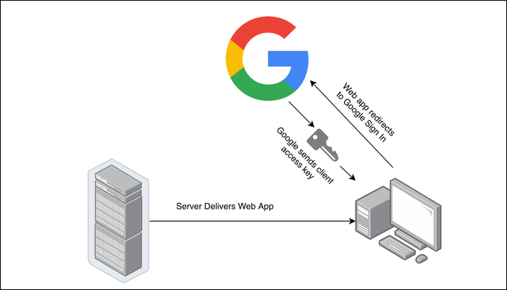

Slide 6
This authorization code functions as the key to the user’s account. Though it isn’t exactly a key; it’s more like an IOU where the client confirms that the server is allowed to access the account. It’s only allowed to be used by your server.
It is only used once, as your server will immediately pass the key to Google to get an access token and ID token, which is used to actually access the user’s account.
In this flow, you’re only requesting access to view basic profile information, so you can identify the user.

Slide 7
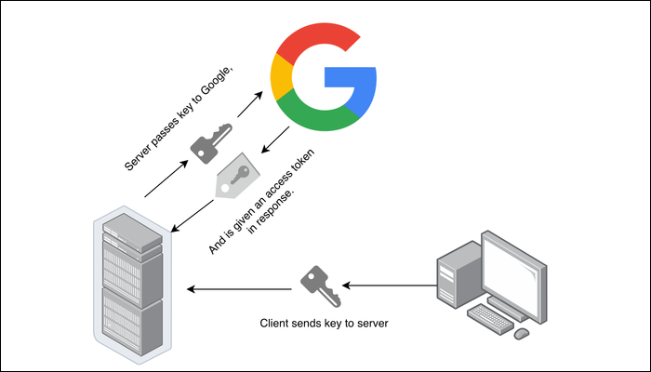

Slide 8
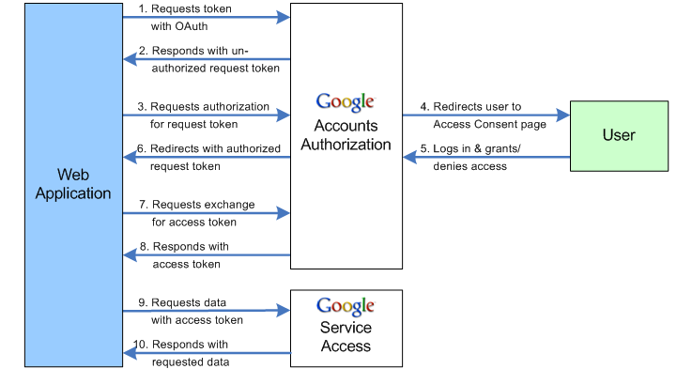

Slide 9
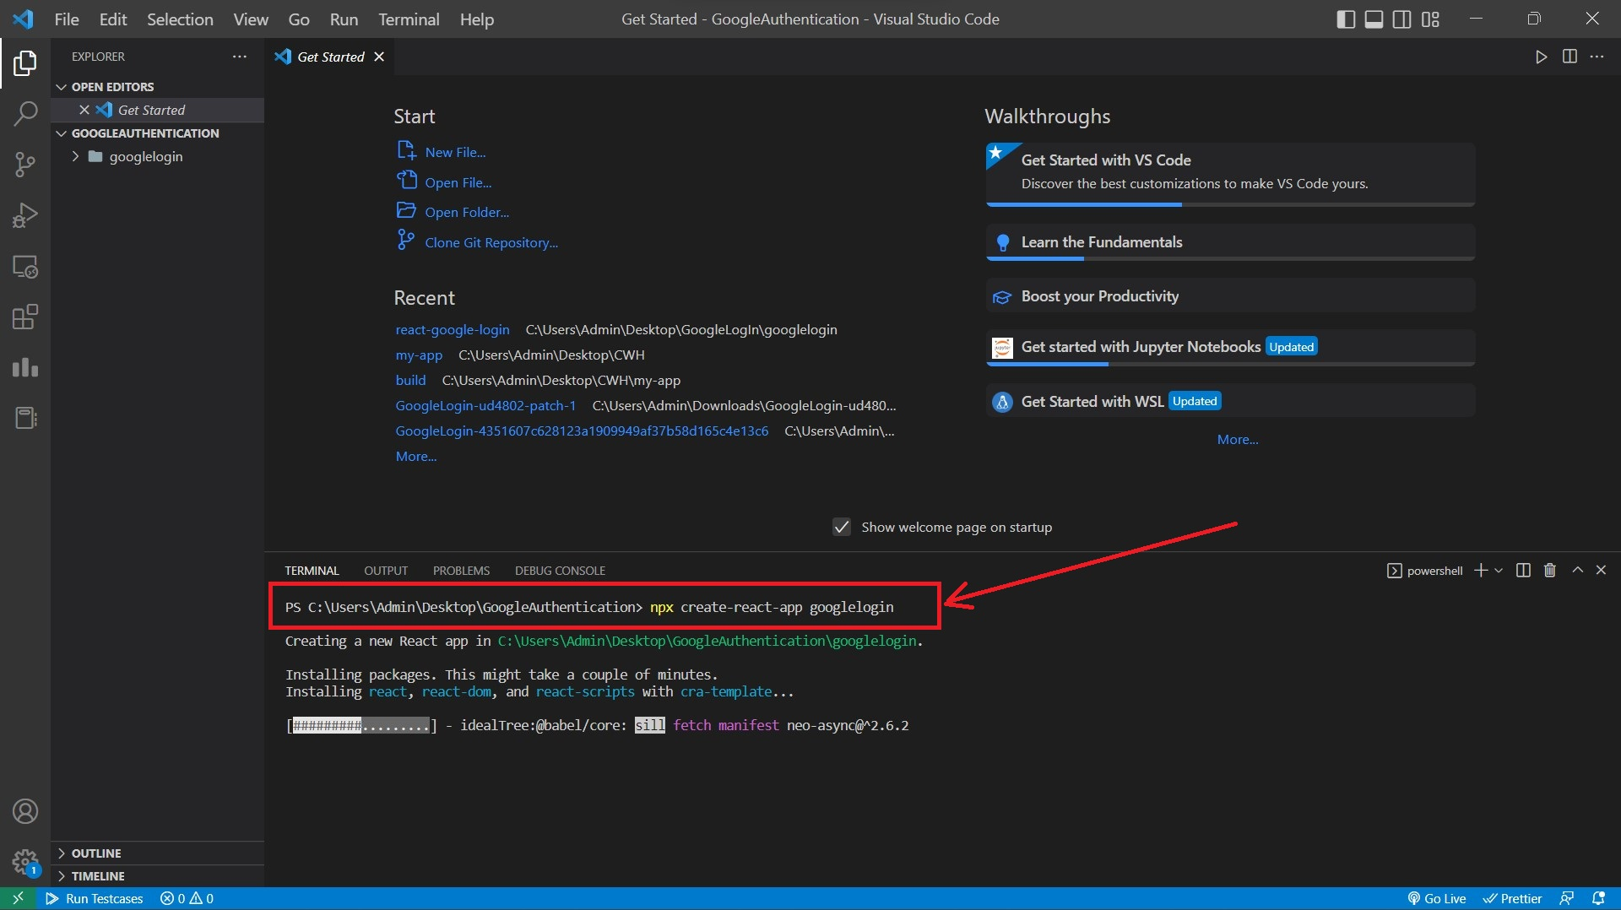
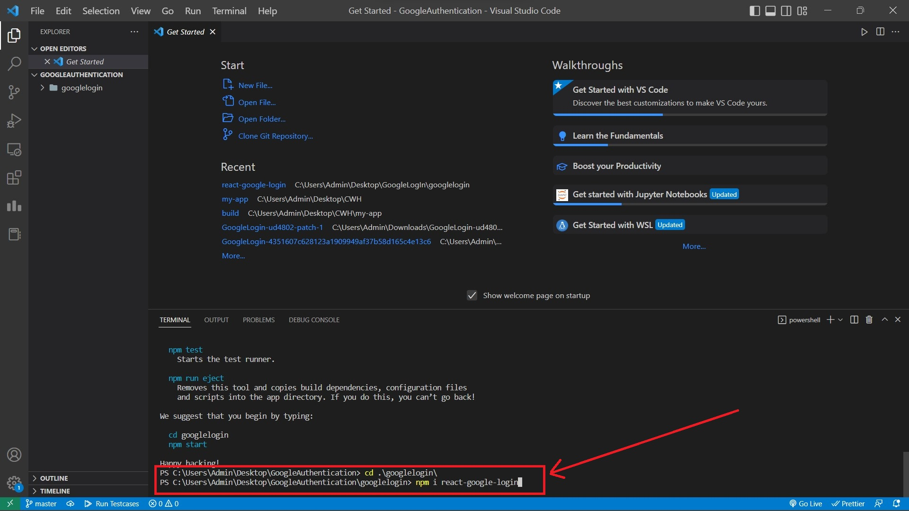
How to set it up? (i) First create react app and install react-google-login package and run

Slide 10
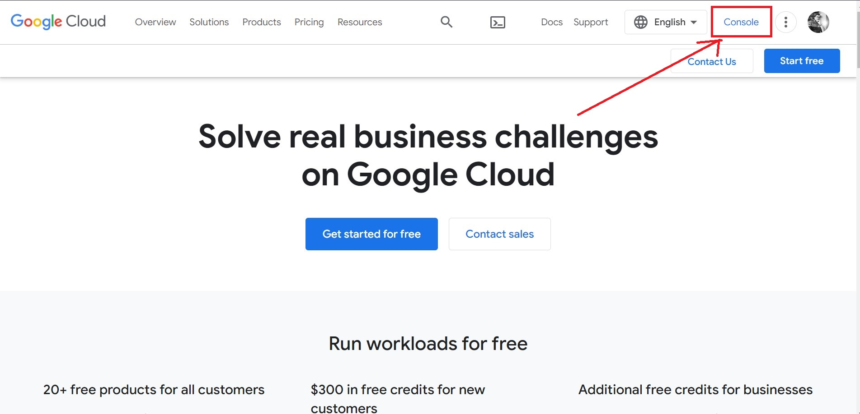
Then, head over to the Google API Console, and create a new project.

Slide 11
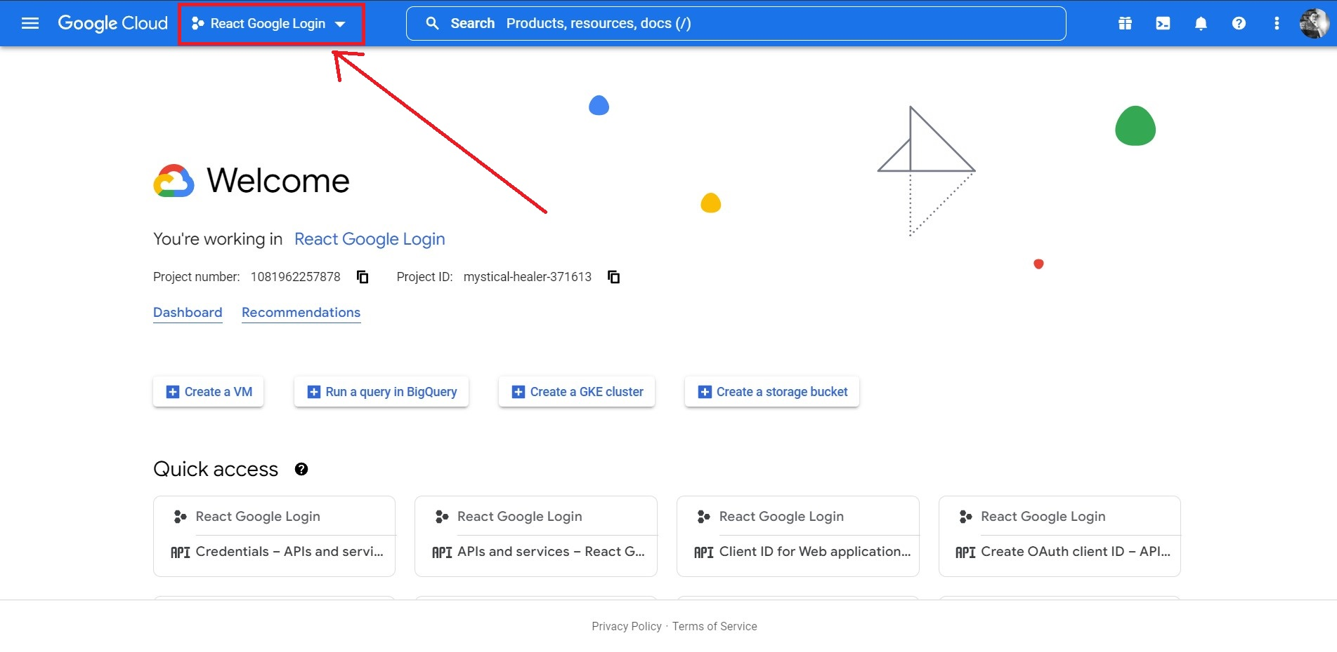

Slide 12
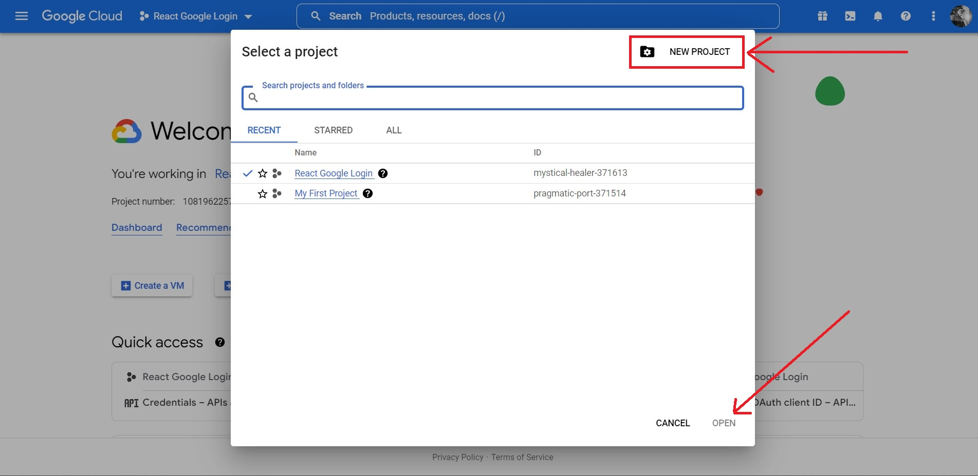

Slide 13
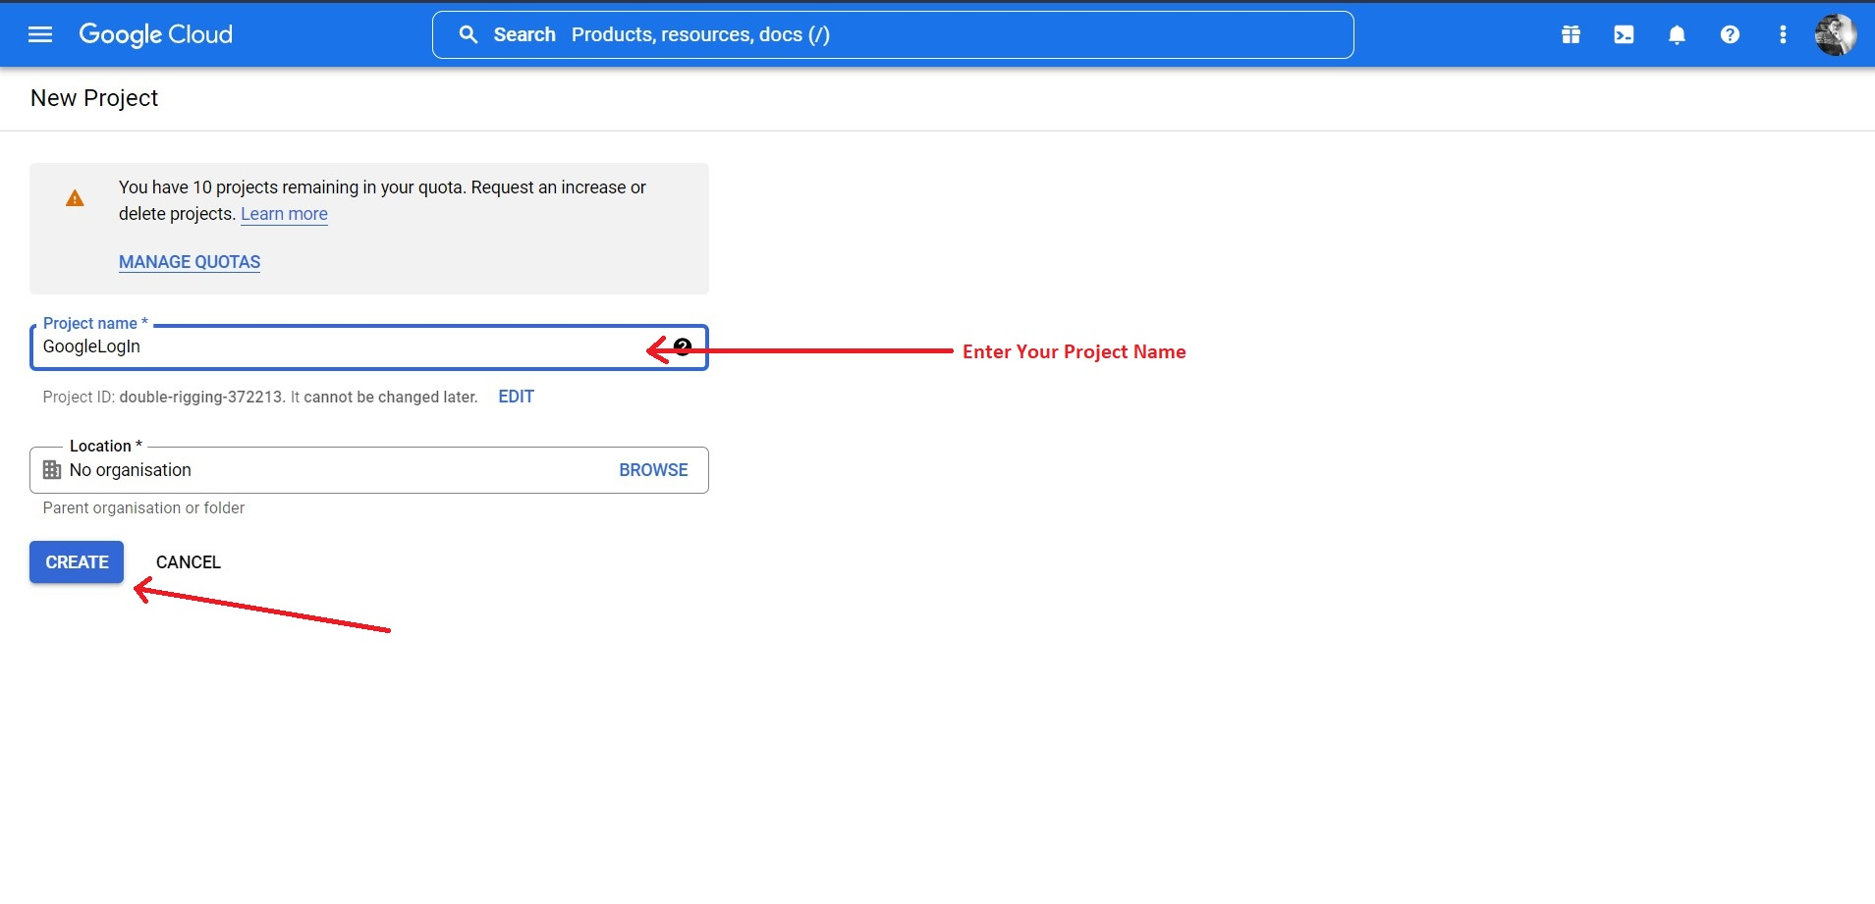

Slide 14
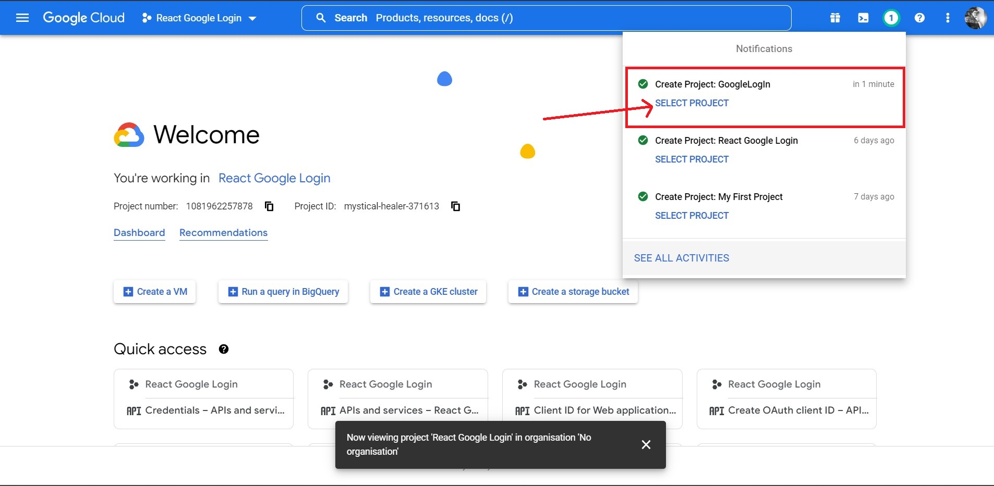

Slide 15
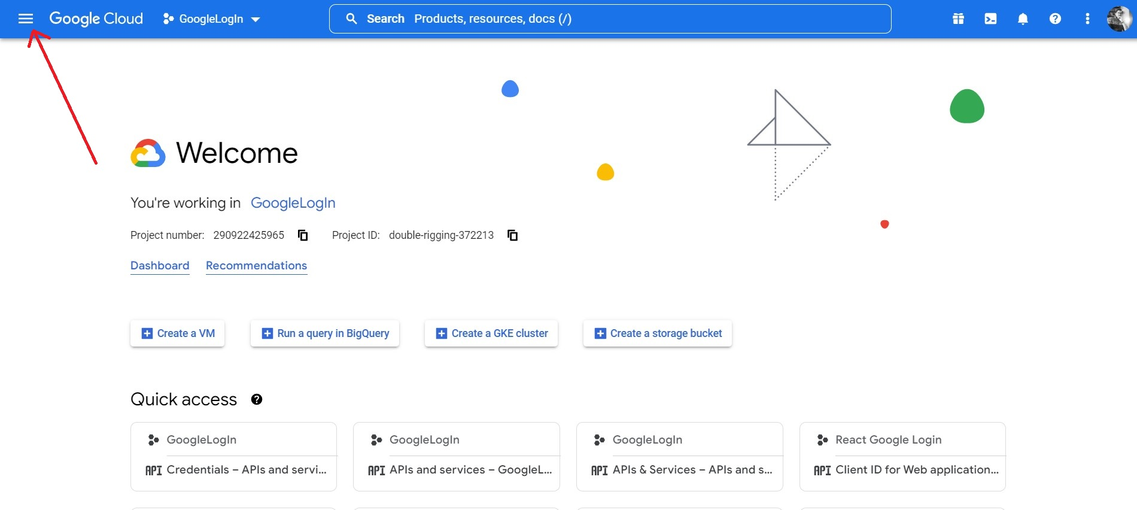

Slide 16
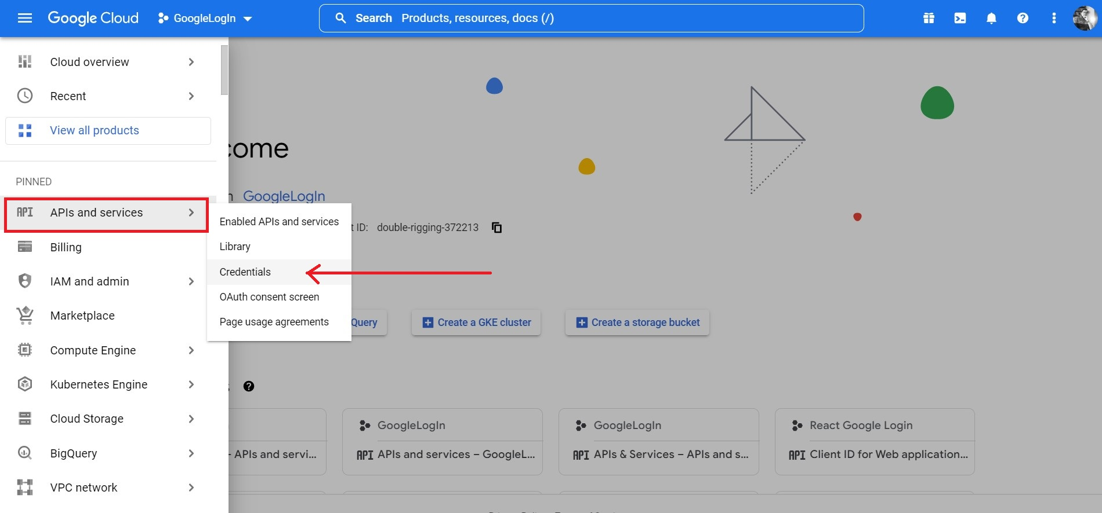

Slide 17
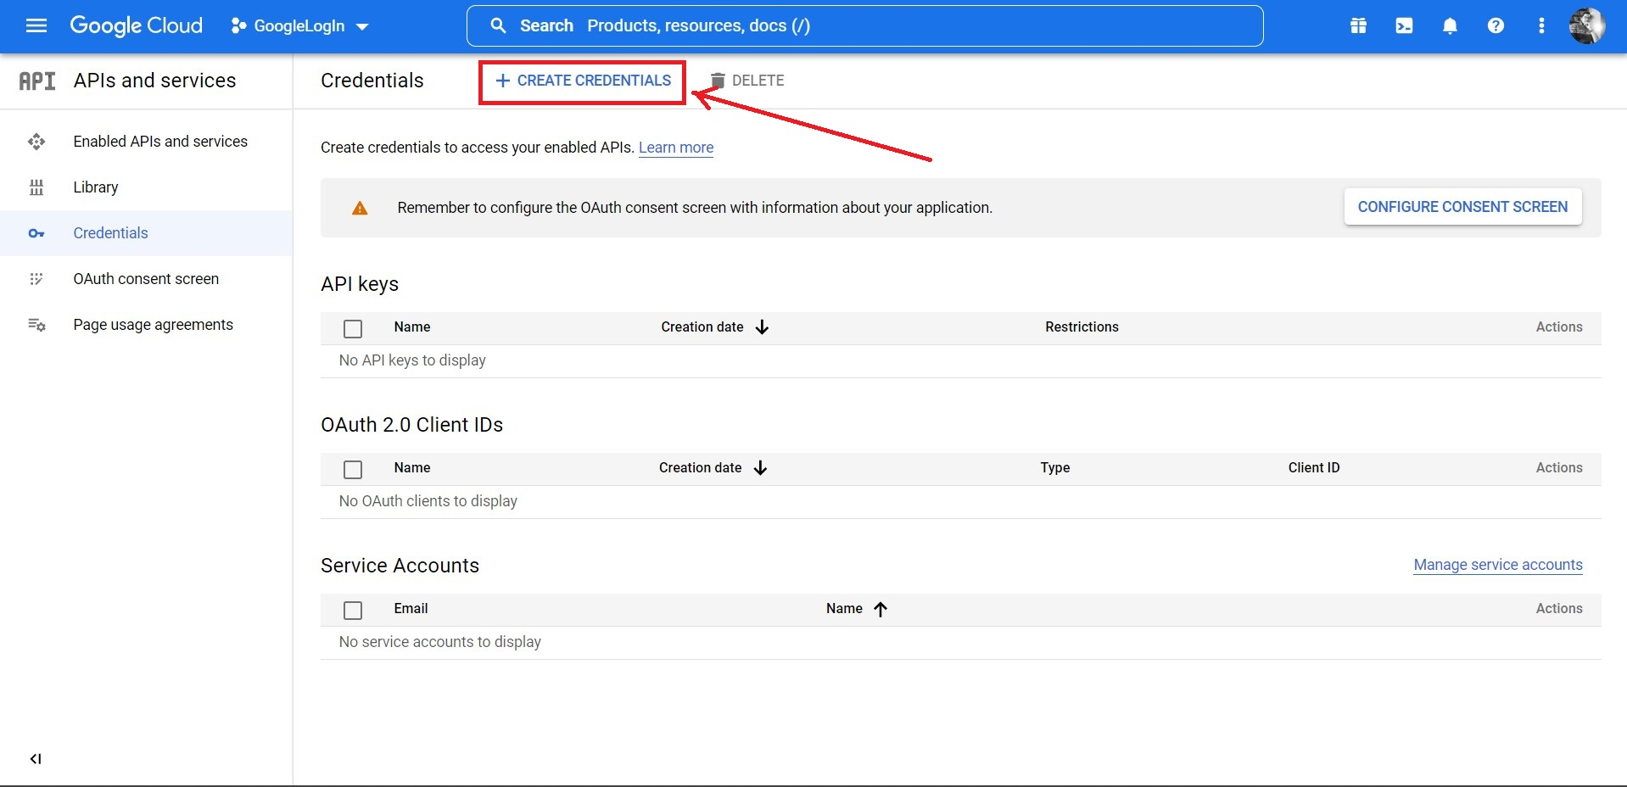

Slide 18
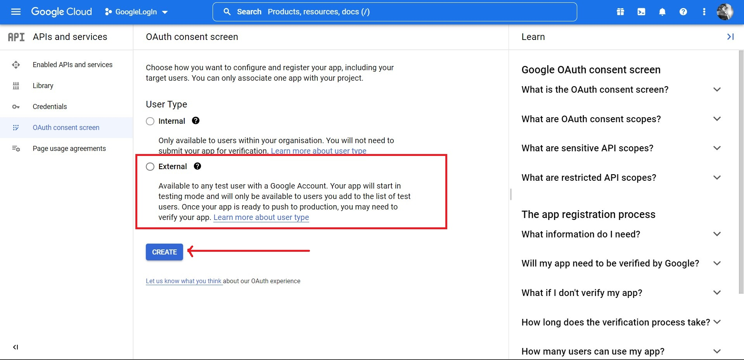

Slide 19
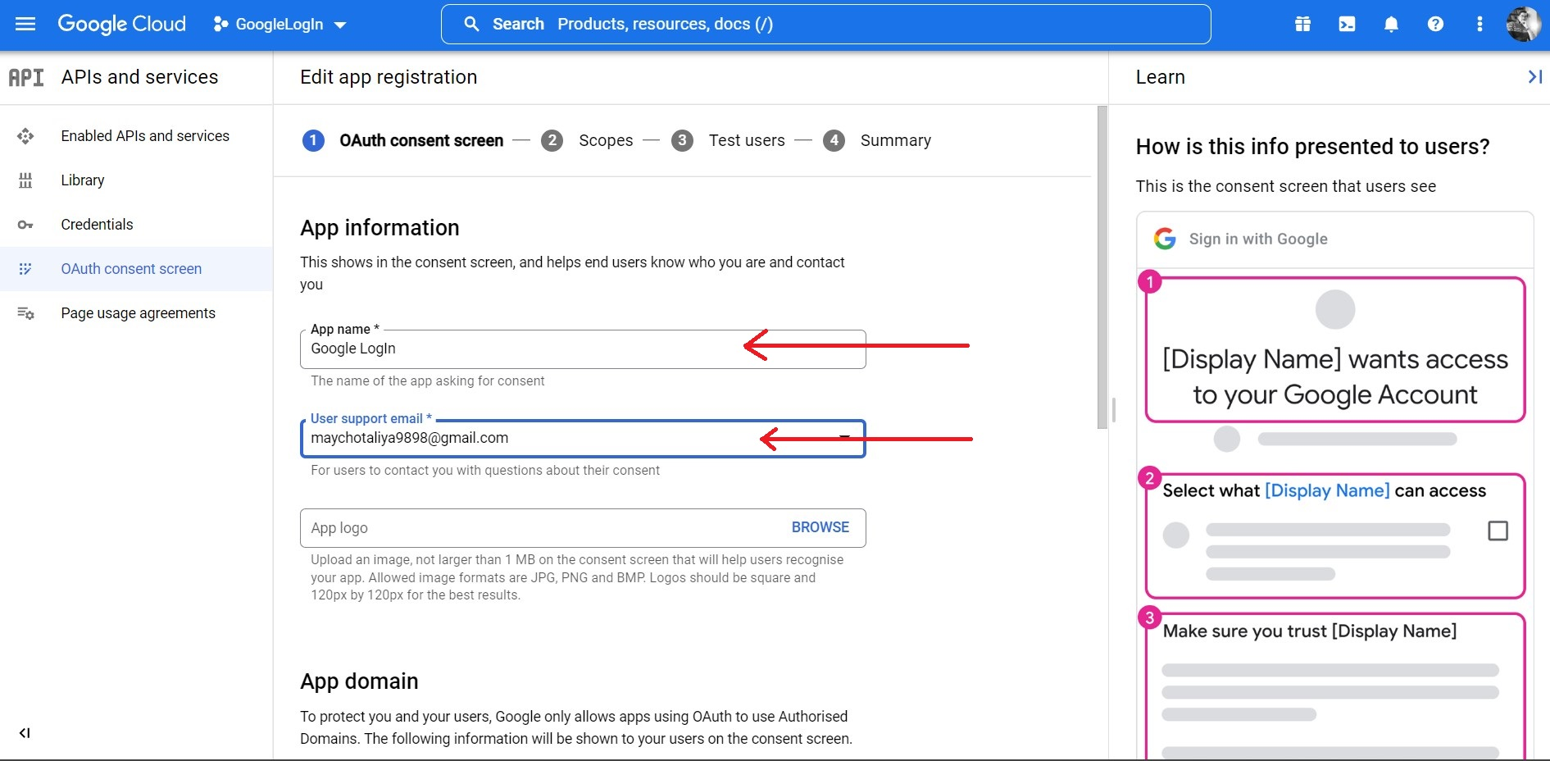

Slide 20
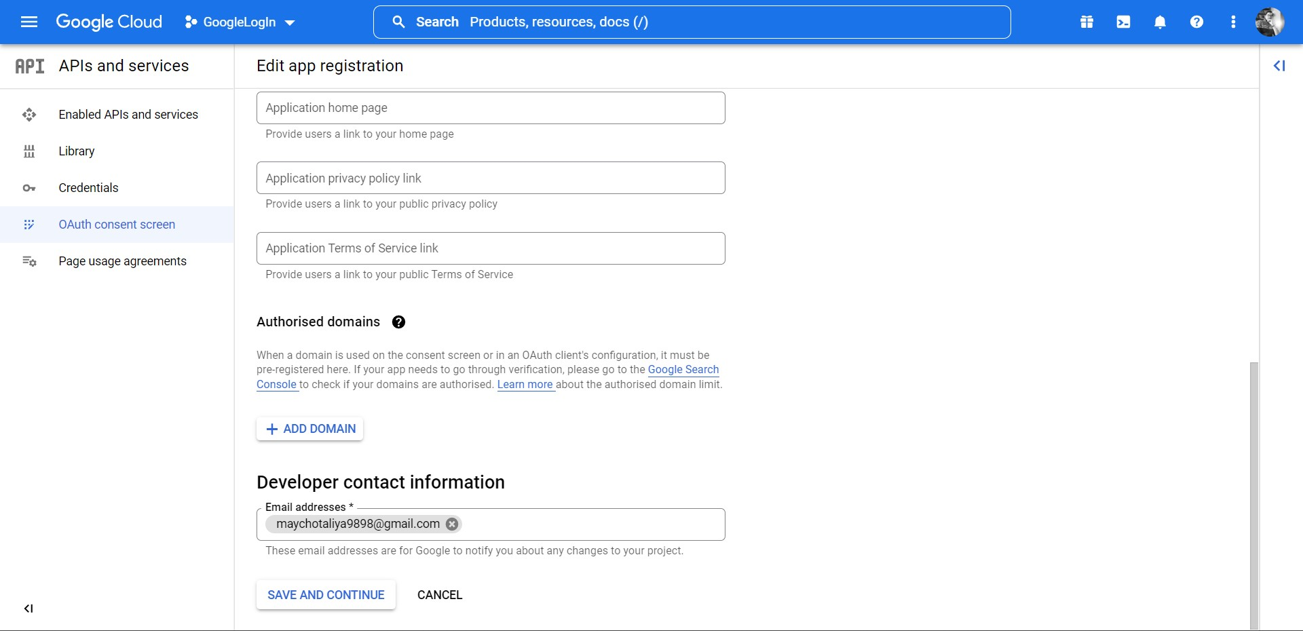

Slide 21
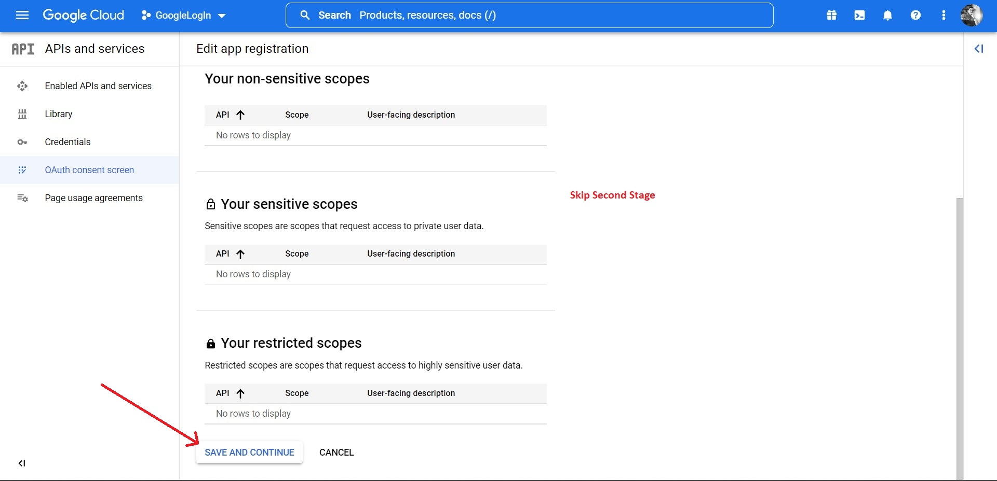

Slide 22
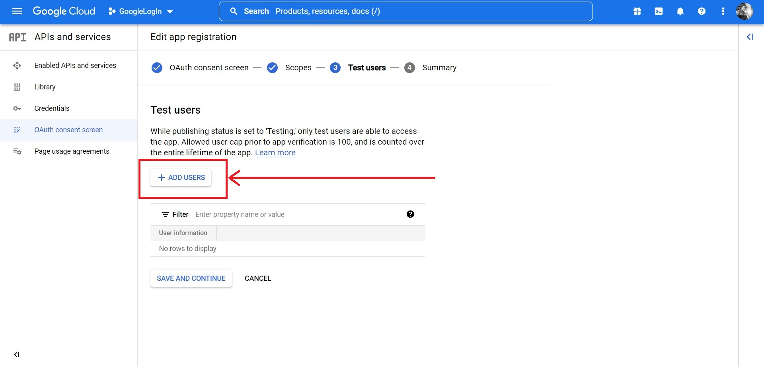

Slide 23
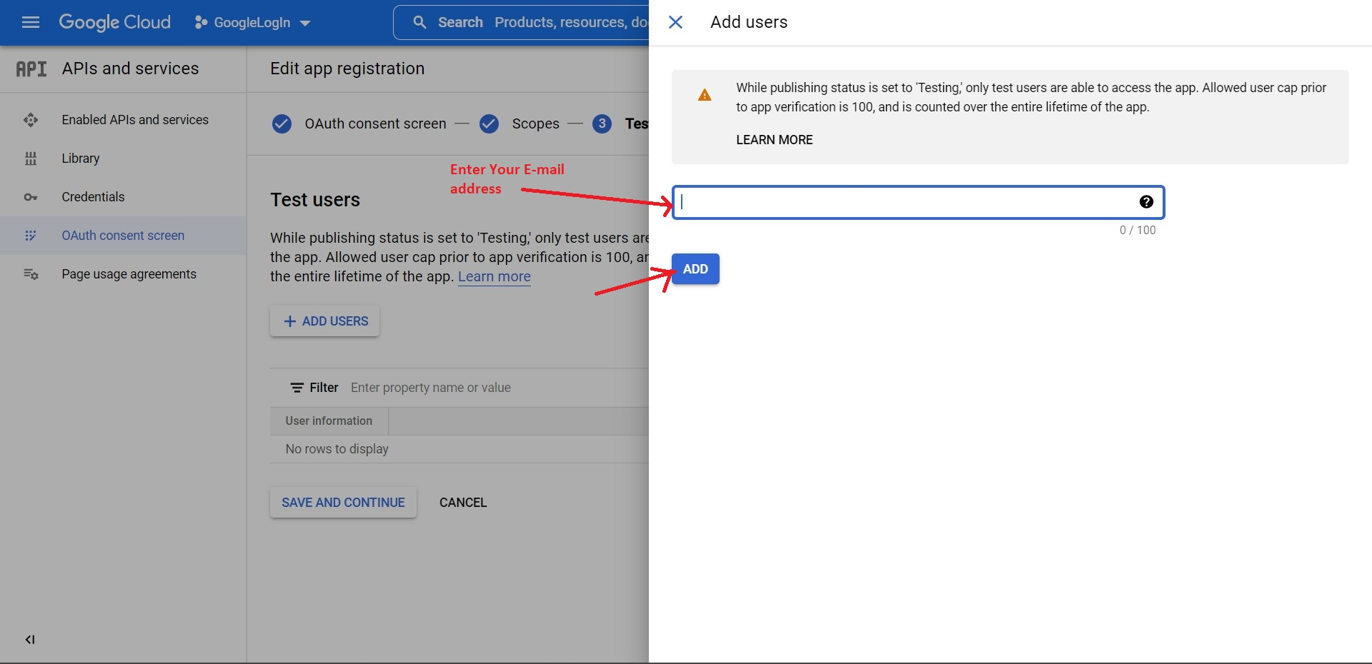

Slide 24
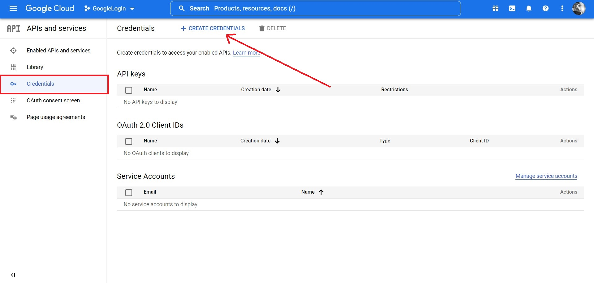

Slide 25
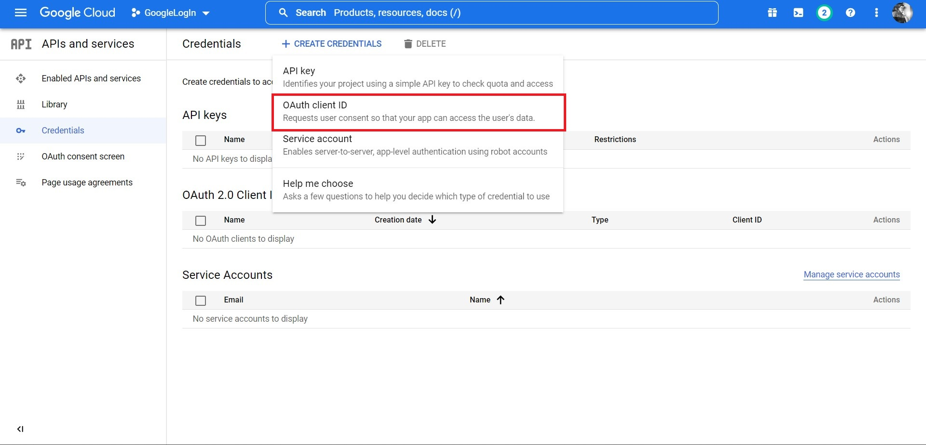

Slide 26
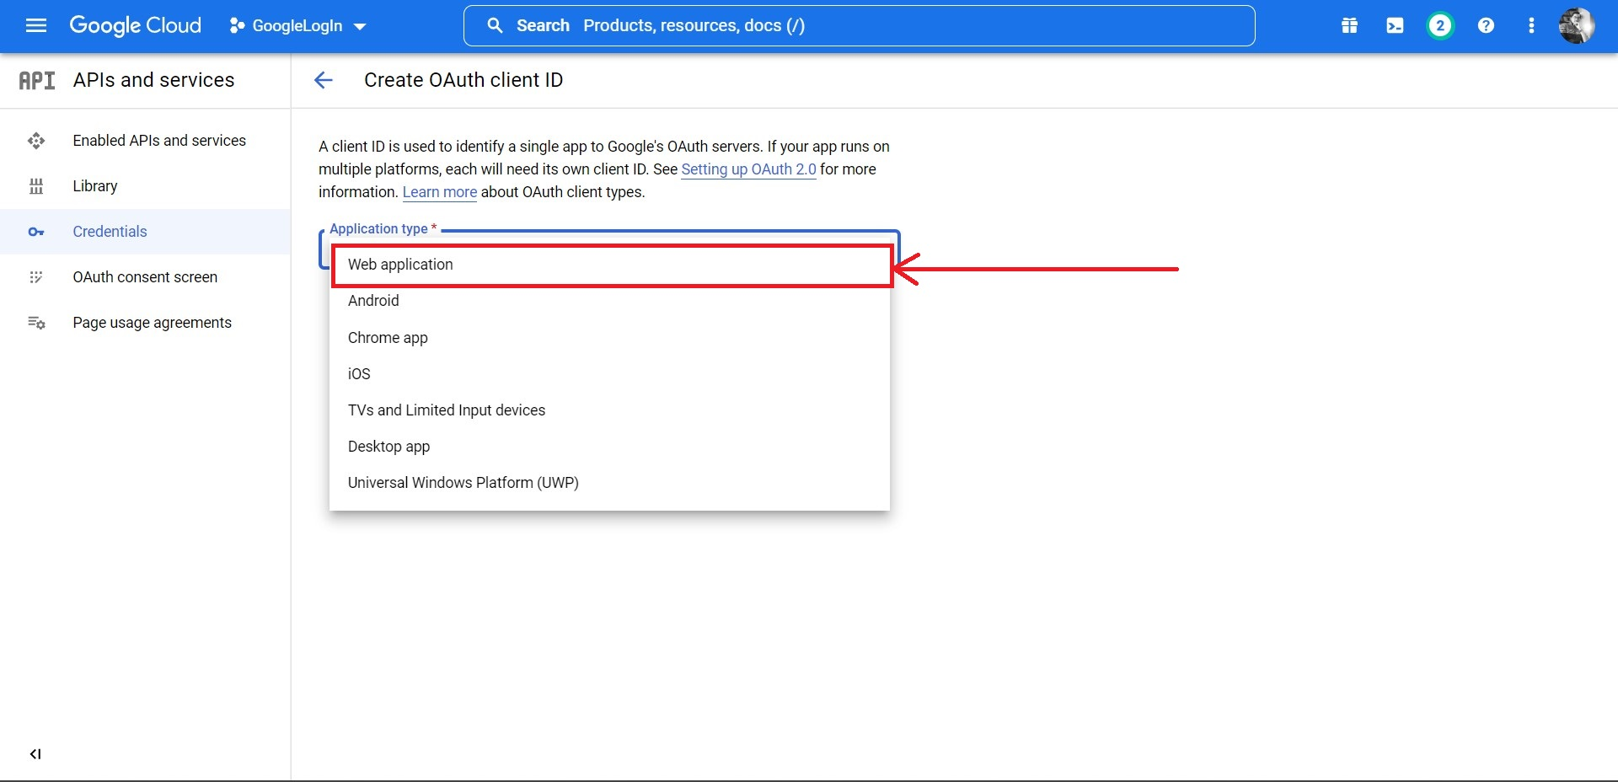

Slide 27
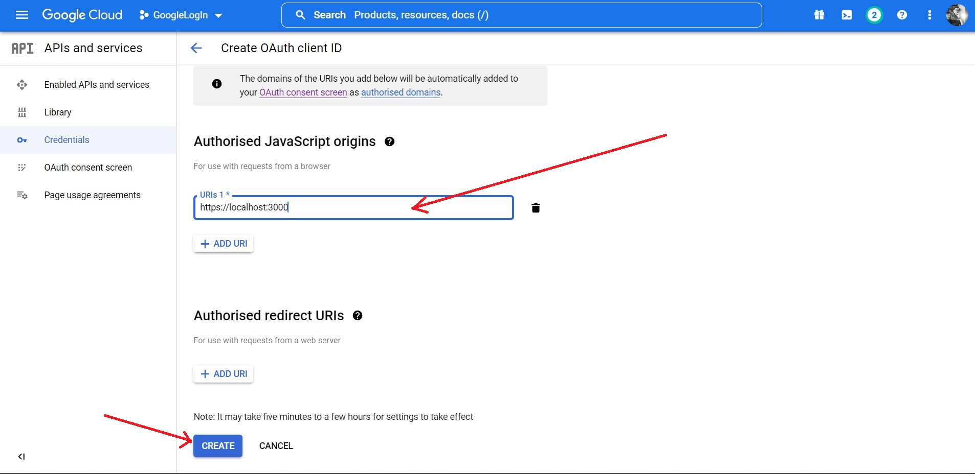

Slide 28
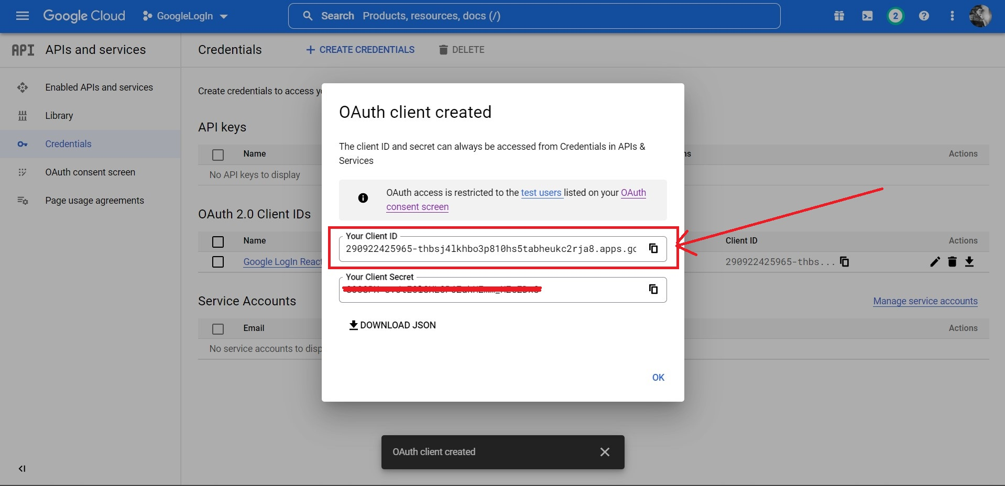

Slide 29
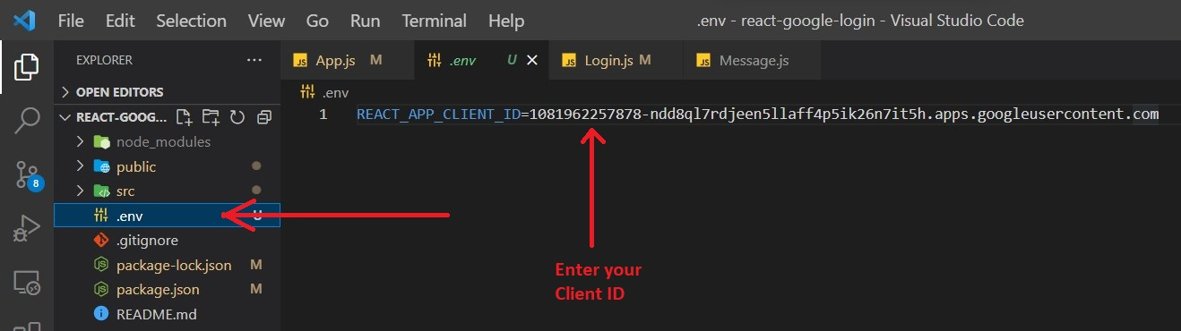
Save Client ID in .env file

Slide 30
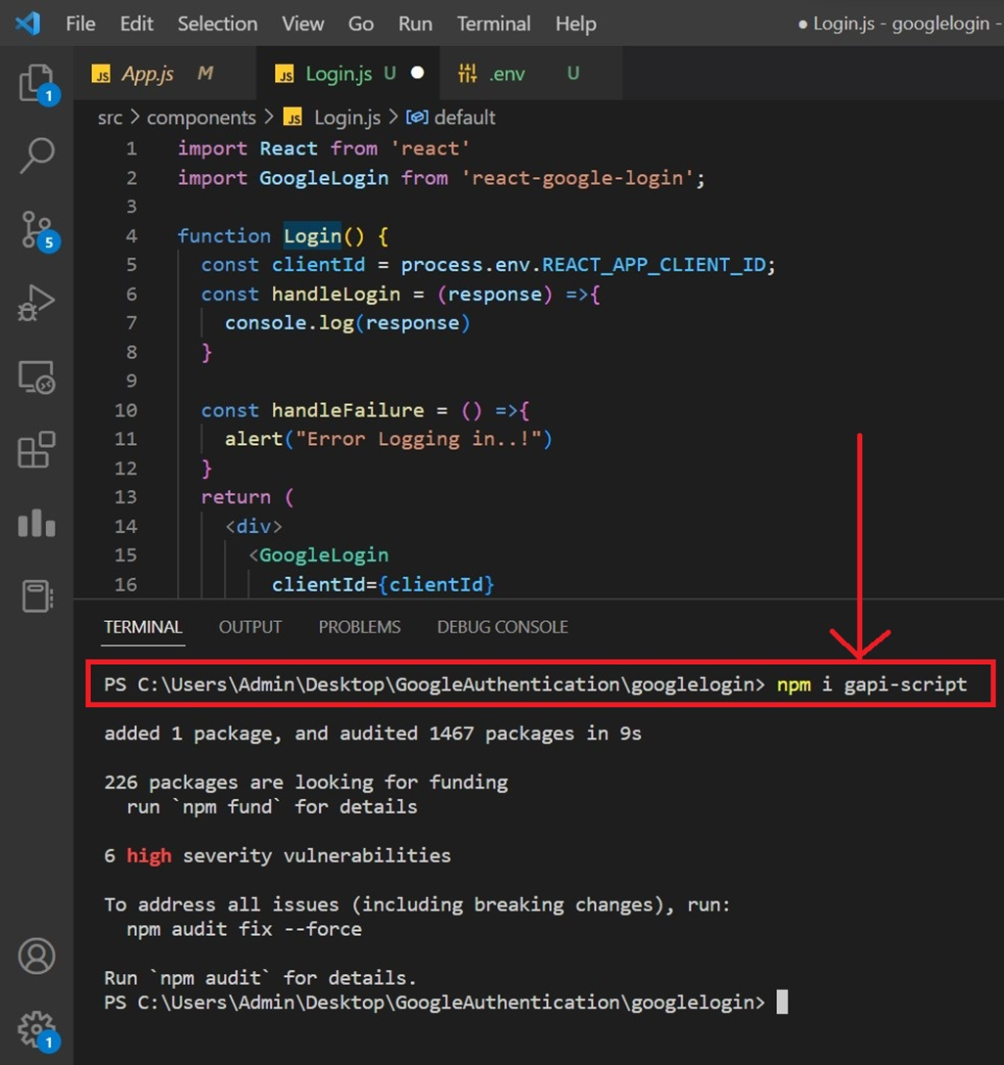
GAPI is Google’s client library for browser-side JavaScript. It’s used in Google Sign-in, Google Drive, and thousands of internal and external web pages for easily connecting with Google APIs.

Slide 31
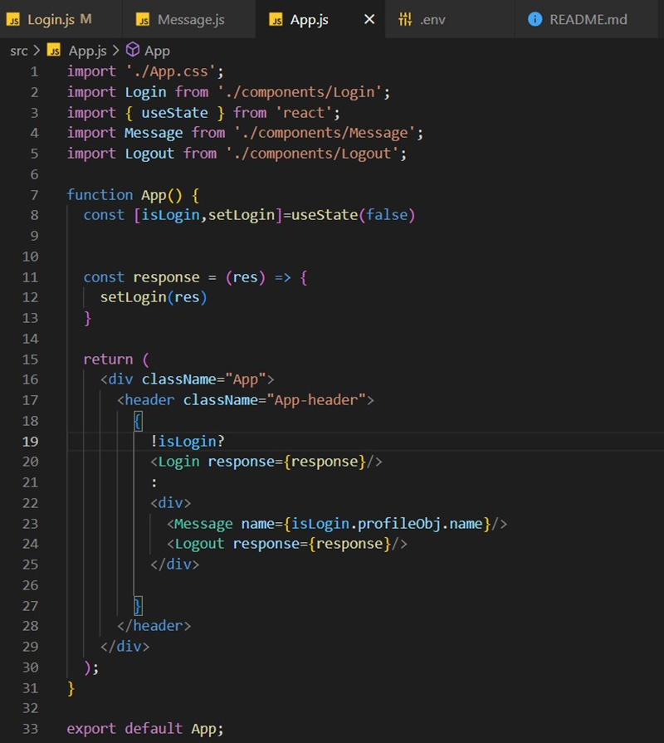
Create four .js file like this

Slide 32
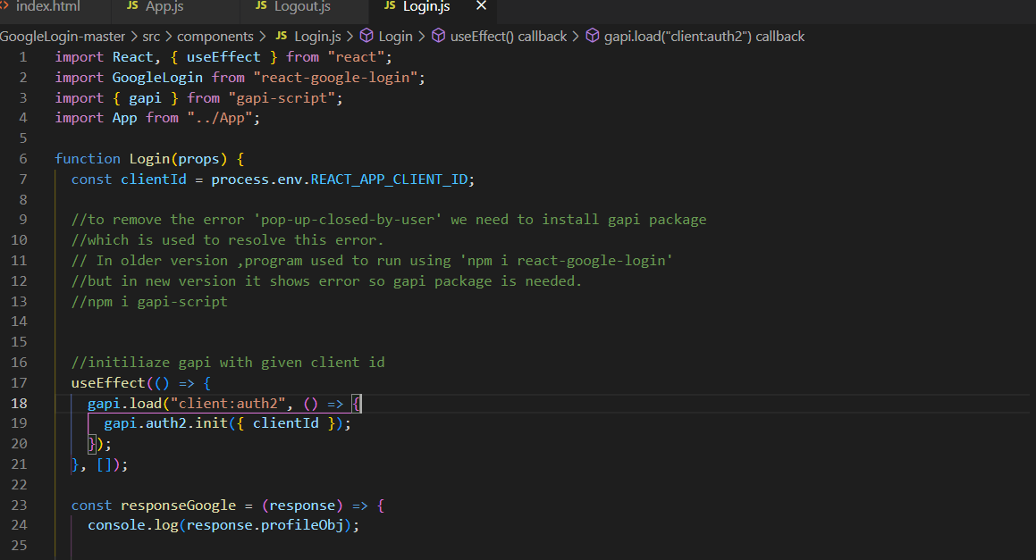

Slide 33
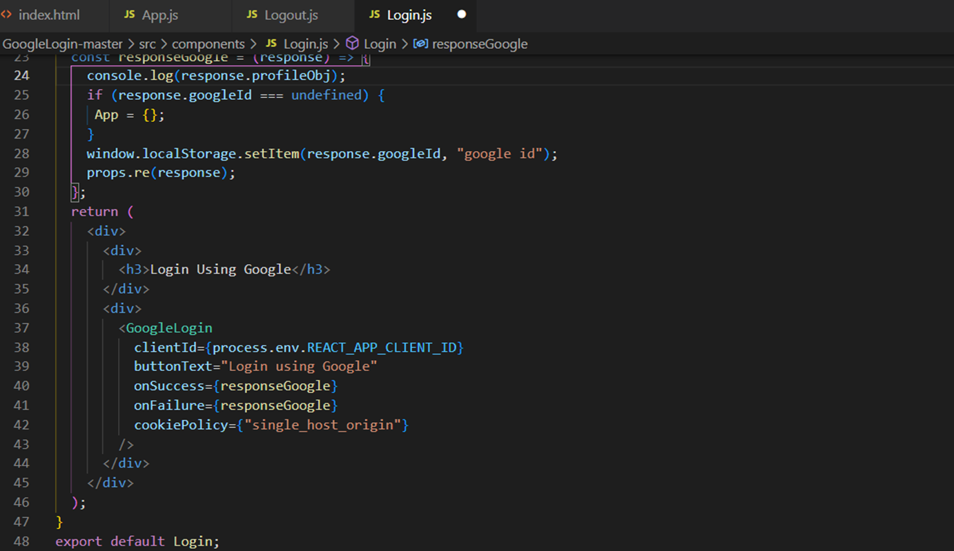

Slide 34
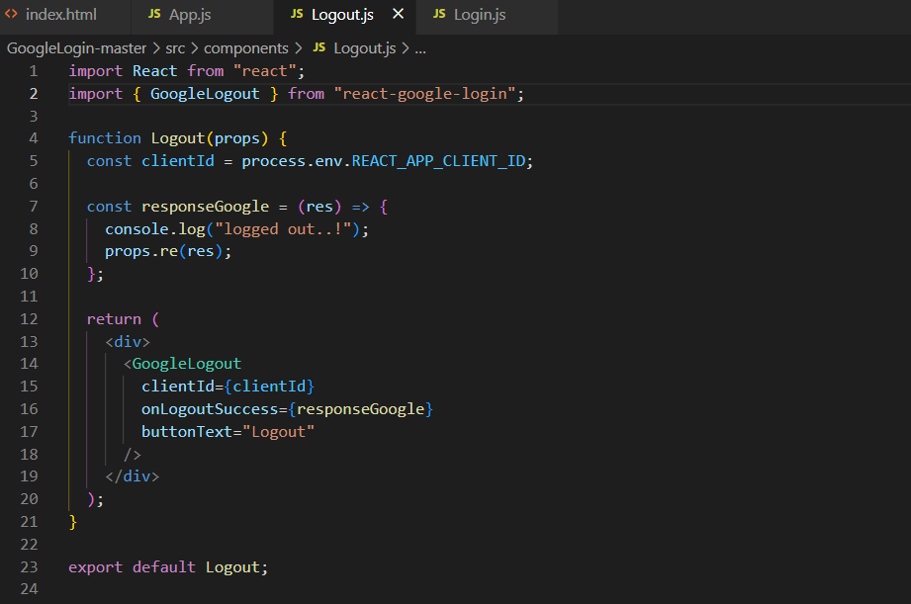

Slide 35
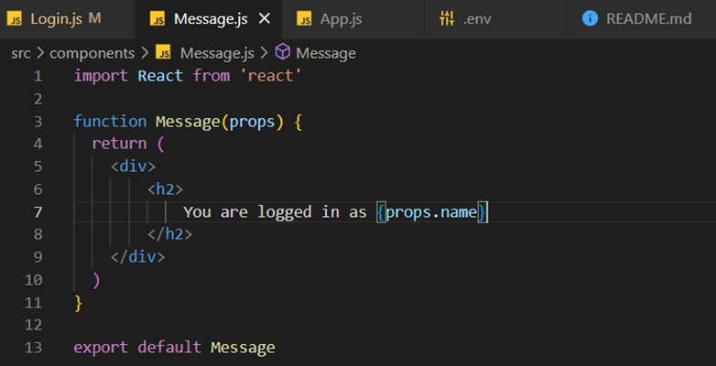

Slide 36
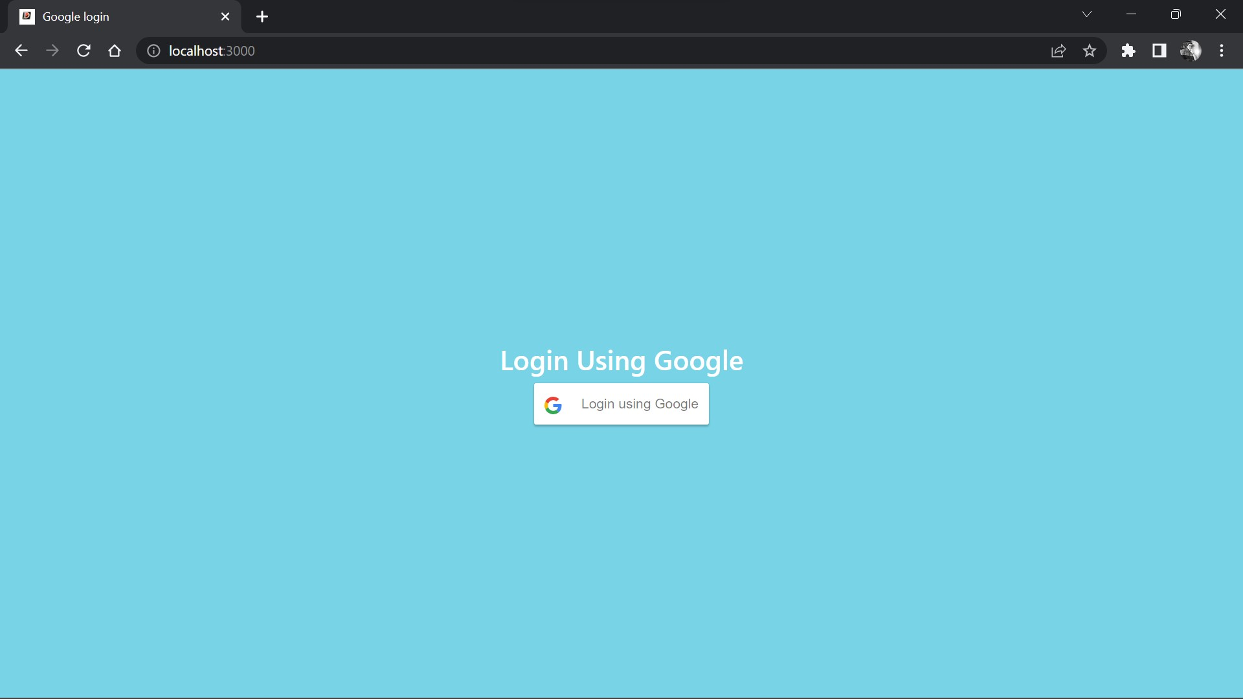
Output

Slide 37
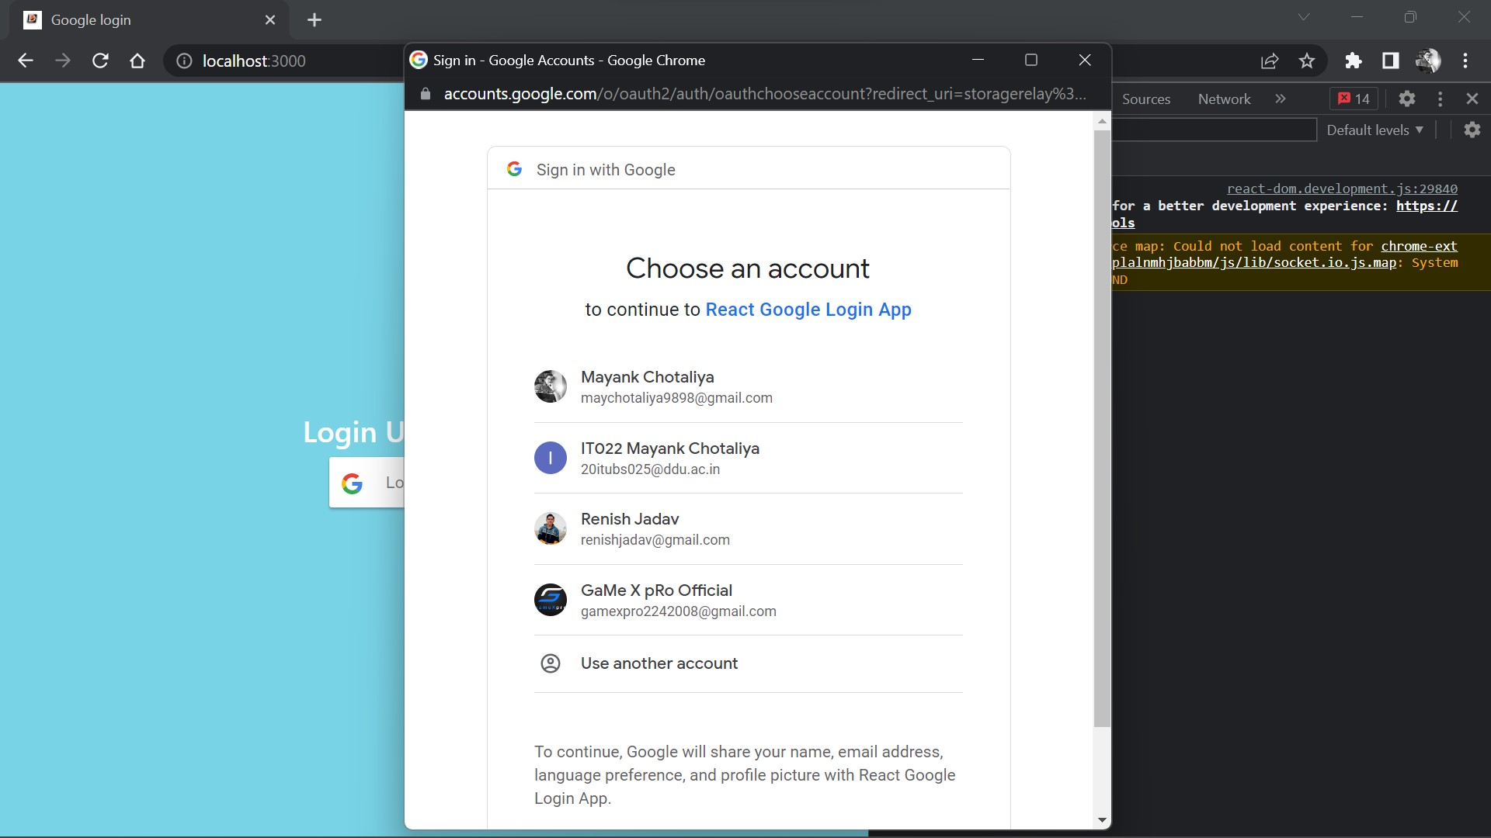

Slide 38
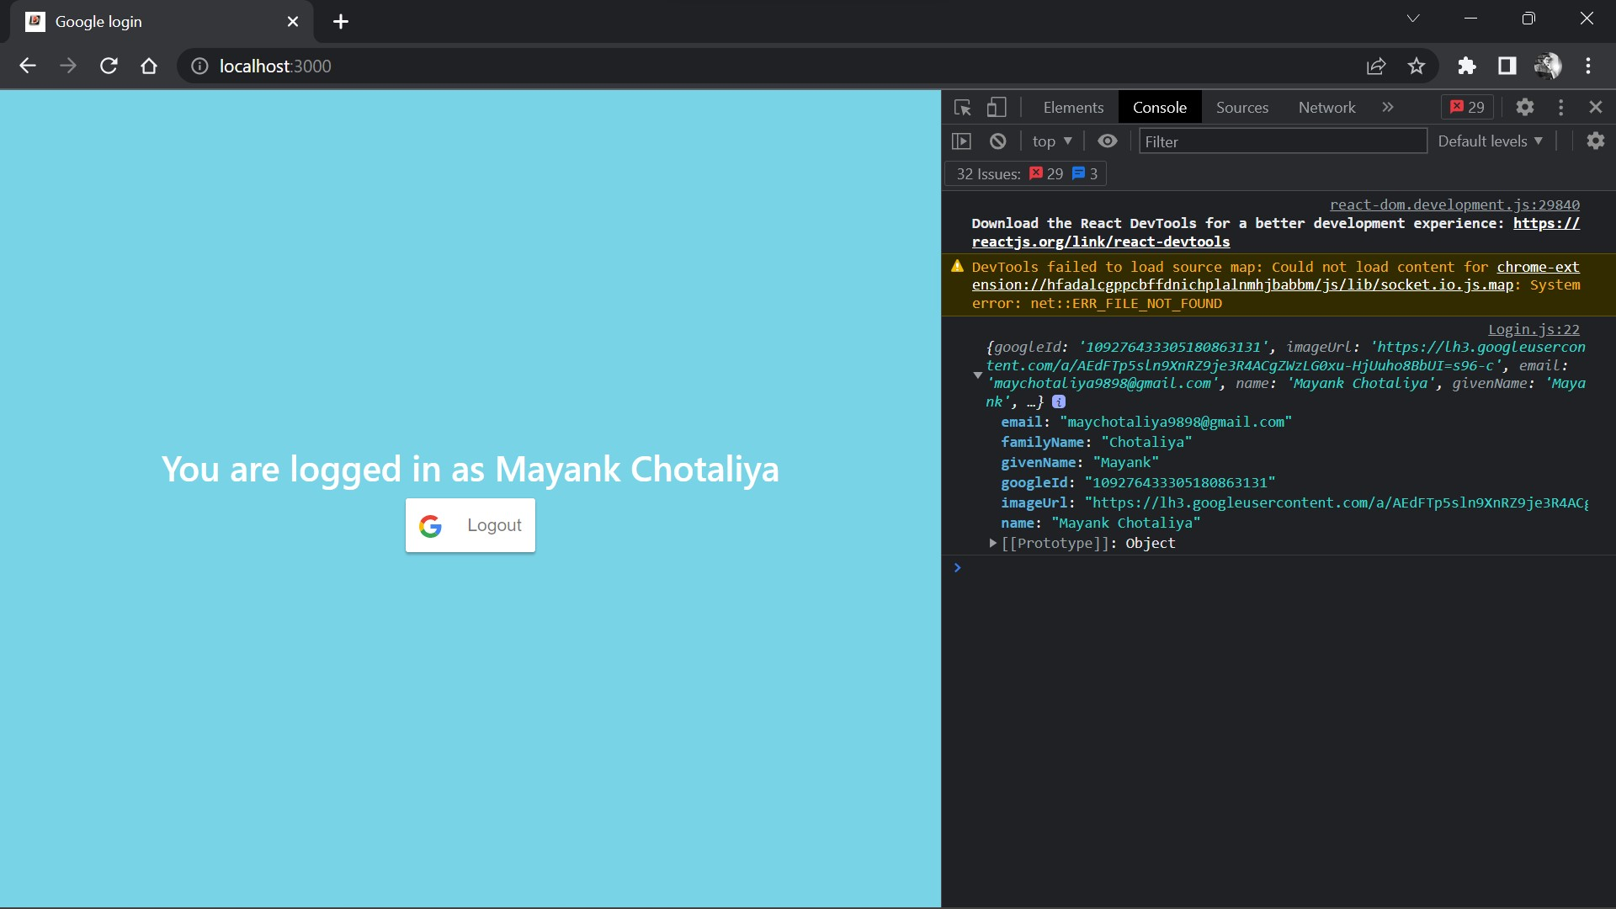

Slide 39
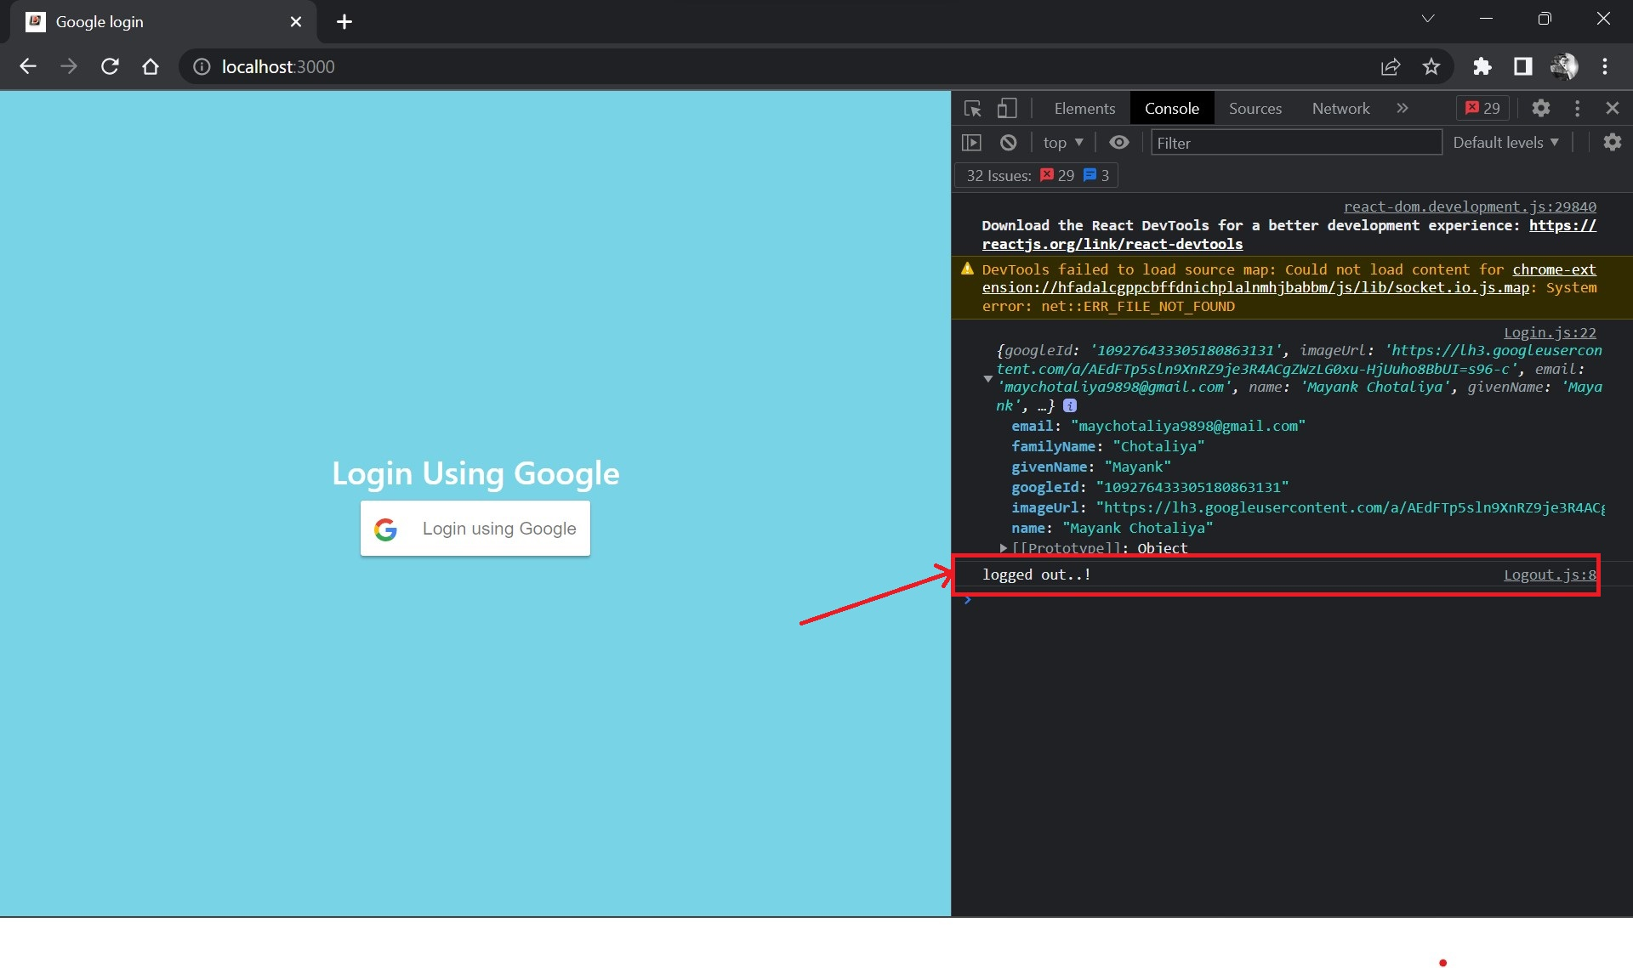

Slide 40
References
https://youtu.be/yOeSpB4wi0s
https://youtu.be/75aTZq-qoZk

Slide 41
Thank You

